Slide 1

Comprehensive Data Analysis of Mobile Phones Dataset
Submitted to: NHIS | Prepared by: Sanskar Pandey

Slide 2
Project Overview & Objectives
Dataset: Analysis of 500+ smartphone listings with 11 features.
Objective: To understand the correlation between hardware specifications and market pricing.
To identify industry standards for essential features like Battery, RAM, and Processor.
To clean and structure raw data for actionable business insights.
Tools: Python (Pandas, Seaborn, Matplotlib, Scipy).

Slide 3
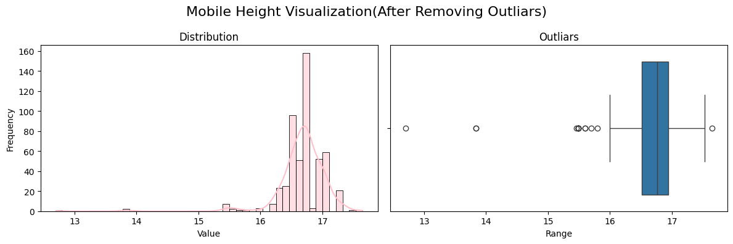
Data Cleaning & Preprocessing
Steps Taken:
Removed redundant columns (Unnamed indices) and handled duplicate entries.
Data Type Correction: Converted 'Price' from string to integer for numerical analysis.
Outlier Management: Identified and removed unrealistic values in 'Mobile Height' (Filtered range: 10cm - 20cm).
Impact: Ensures that our average price and dimension calculations are not skewed(except the Flagship prices) by erroneous data.

Slide 4
Feature Engineering
Objective: Transforming raw specs into strategic categories.
New Features Created:
Price Segment: Classified phones into 'Budget' (<10k), 'Mid-Range' (10k-25k), and 'Flagship' (>25k).
Processor Brand: Extracted core brand names (Snapdragon, MediaTek, Unisoc).
Mobile Brand: Isolated brand names from model text for brand-value analysis.
Price per GB RAM: Calculated efficiency metric to find "Value for Money" devices.

Slide 5
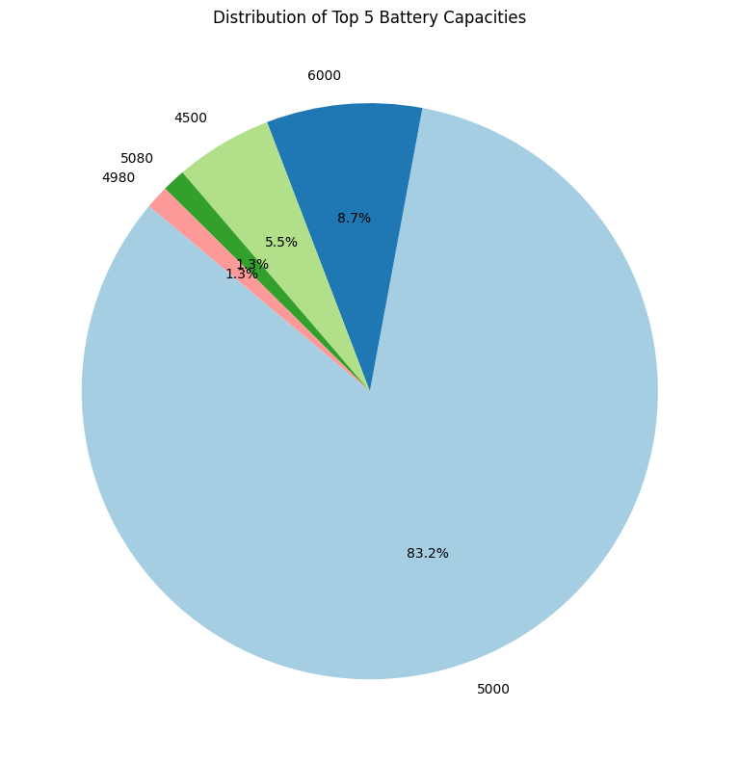
Univariate Analysis: Hardware Distribution
Analysis: * RAM & Memory: The market is dominated by 4GB/8GB RAM and 64GB/128GB storage configurations.
Battery: 5000mAh has emerged as the "Universal Industry Standard" (shown in 40%+ of devices).
Observation: Most manufacturers are converging on a standard battery size regardless of price.

Slide 6
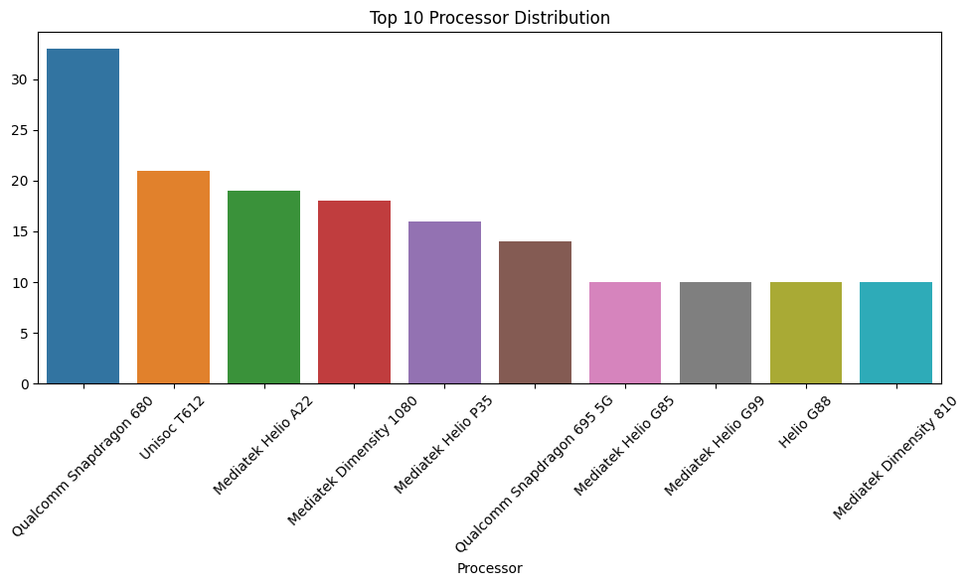
Univariate Analysis: Brand & Processor Trends
Key Findings:
Market Concentration: A few processors (like MediaTek Helio and Snapdragon series) dominate the majority of the listings.
Product Variety: High variety in models but limited variety in core chipsets used.
Observation: The choice of processor is a key differentiator for brands in the Mid-Range segment.

Slide 7
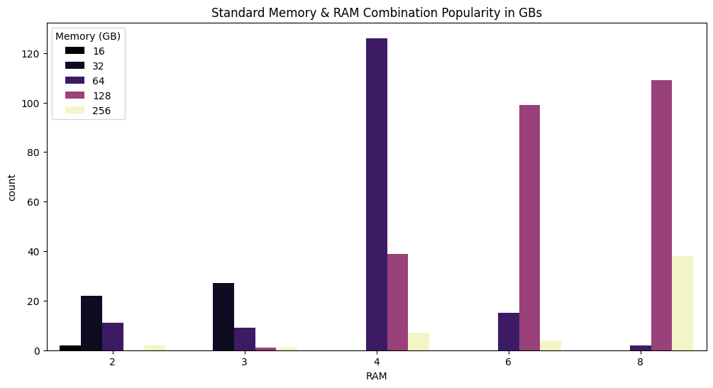
Bivariate Analysis: Feature Combinations
Analysis:
RAM vs. Memory: Strong clustering around (4GB RAM, 64GB ROM) and (8GB RAM, 128GB ROM).
Camera Synergy: A strong positive correlation exists between Front and Rear camera megapixel counts.
Insight: Brands maintain a "Balanced Spec Sheet" to appeal to standard consumer expectations.

Slide 8
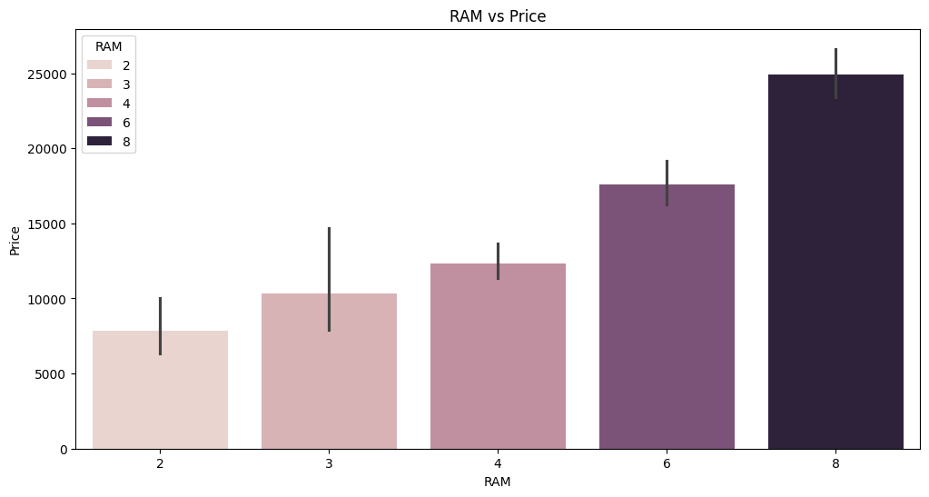
Bivariate Analysis: The Price Drivers
Finding 1: RAM is the most aggressive driver of price. Moving from 4GB to 8GB RAM typically results in a significant price tier jump.
Finding 2: Interestingly, Battery capacity has a weak relationship with Price. A 5000mAh battery is found in both ₹8,000 and ₹50,000 phones.
Conclusion: Battery is a "utility" feature, while RAM is a "premium" feature.

Slide 9
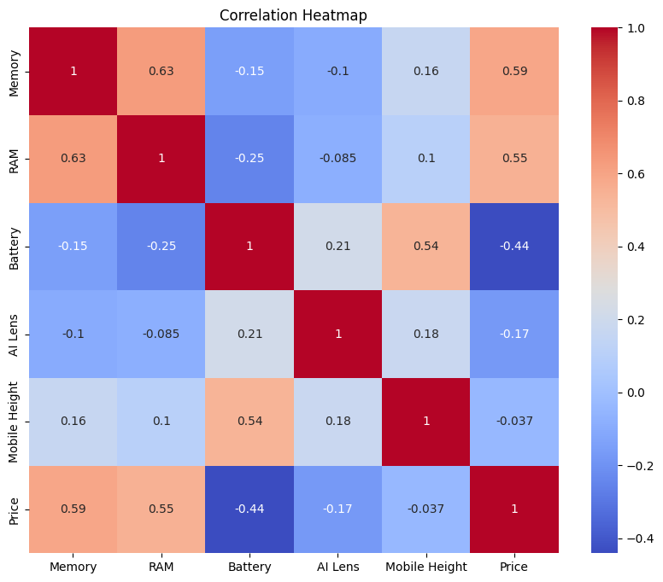
Multivariate Analysis: Deep Dive
Relationship Mapping: By analyzing RAM and Price with Processor types, we see that "Premium Brand" processors (like Snapdragon 695) command higher prices even with identical RAM.
Correlation Heatmap: Confirms that RAM and Memory have the highest numerical impact on the final retail price.

Slide 10
Segment Analysis (Engineered Insight)
Analysis of Price per GB RAM:
Budget Segment: Offers the highest "Price per GB" efficiency.
Flagship Segment: Consumers pay a high premium for brand value and processor speed, even if RAM stays at 8GB.
Insight: The "Value for Money" sweet spot lies in the Mid-Range segment with MediaTek Dimensity or Snapdragon 6-series chips.

Slide 11
Key Takeaways for NHIS Procurement
Optimization: Avoid "Flagship" outliers unless high-end processing is mandatory.
Spec Standard: 6GB RAM and 128GB Storage with a 5000mAh battery provide the best long-term utility.
Brand Choice: MediaTek-powered devices offer better cost-efficiency for large-scale administrative deployment.
Dimension Standards: Stick to "Standard" size (16cm-17cm) for better ergonomics and case availability.

Slide 12
Final Conclusion
The smartphone market is standardized on battery and dimensions but highly tiered based on RAM and Processor Brand.
Strategic procurement should focus on the Mid-Range segment to maximize hardware lifespan while minimizing brand-tax expenditures.
Data Integrity: Regular outlier checks in "Mobile Height" and "Price" are necessary to maintain accurate market forecasts.

